Slide 1
Sdsoc intro

Slide 2
Newest version-2019.1, after that, merge into vitis
Installation also include vivado,HLS,SDK
Supported HW:zc702,706,zedboard,zcu102,104,106. others made from custom platform.
need install 32-bit library:
Centos7: yum install glibc-devel.i686
Provide framework for sw app & hw acceleration in embedded processor application

Slide 3
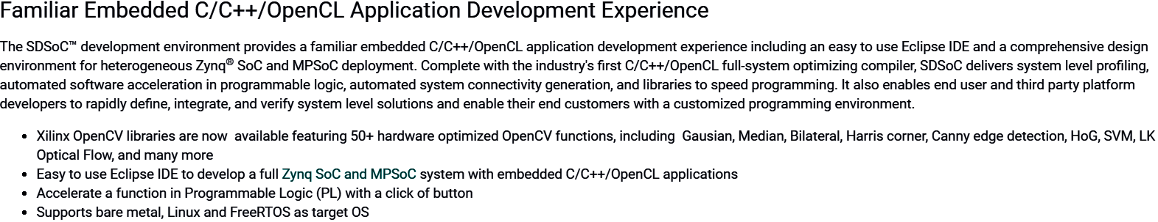
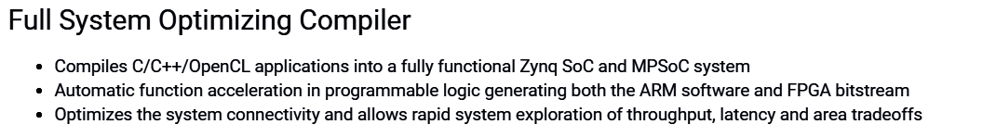

Slide 4
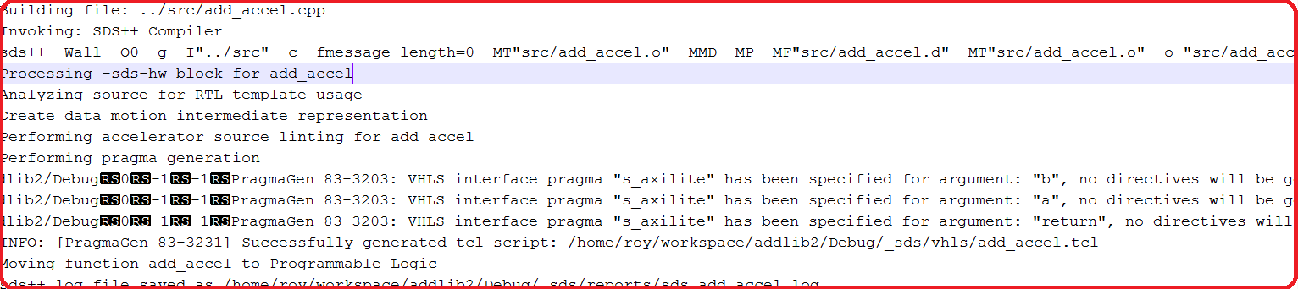
Execution
Sds++ compiler invokes HLS tools on the desired function & generate IP

Slide 5
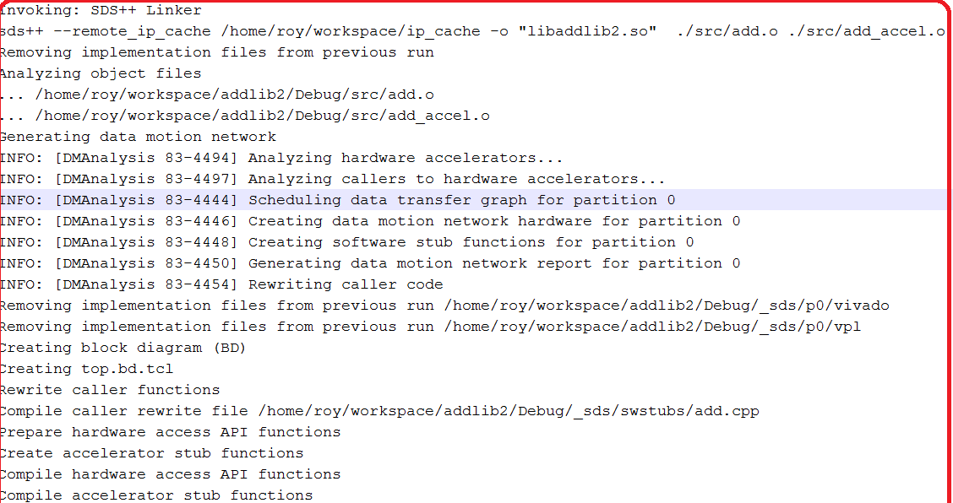
Sds linker analyze program dataflow & hw function call mapping into software control code(stubs)

Slide 6
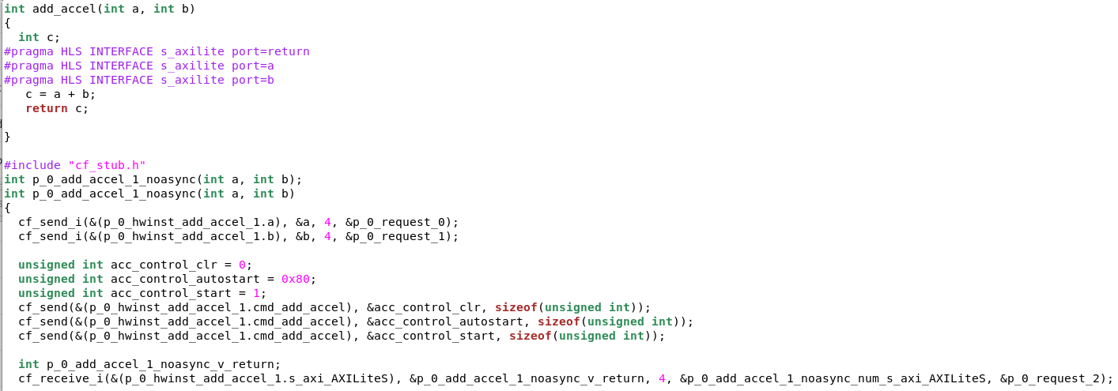
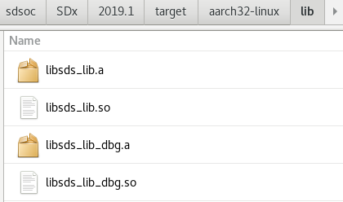
Within the stub, all accelerator and data mover control is realized through a set of send & receive API provided by sds_lib library.

Slide 7
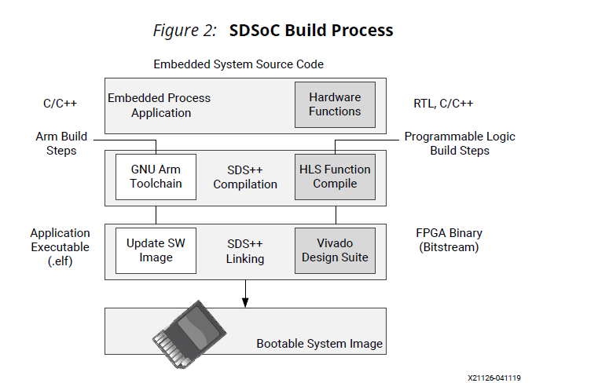
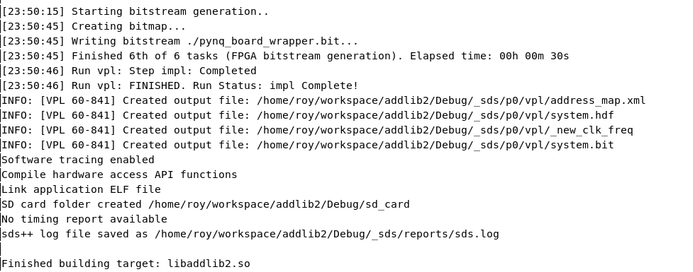
Build process
Sds++ compiler invokes HLS, Vivado Design Suit to implement the hardware system and sds++ linker to create app binaries run on the CPU by outputting a complete bootable system for SD card.

Slide 8
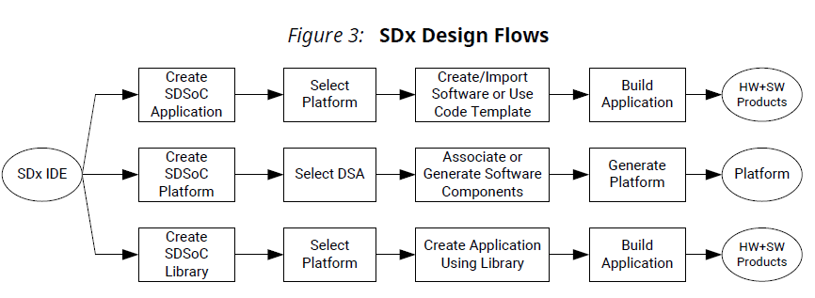
Design flow
Three kinds of design project.
A. application. B. platform C. library

Slide 9
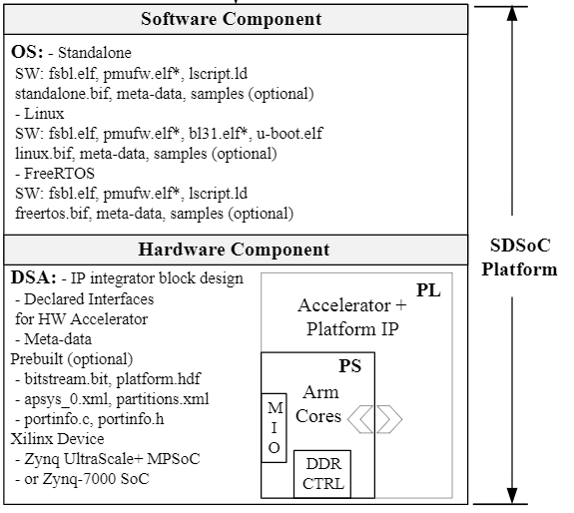
Platform project
Platform: SW+HW
SW-OS, boot loaders, drivers, root file sys
HW-PS+PL

Slide 10
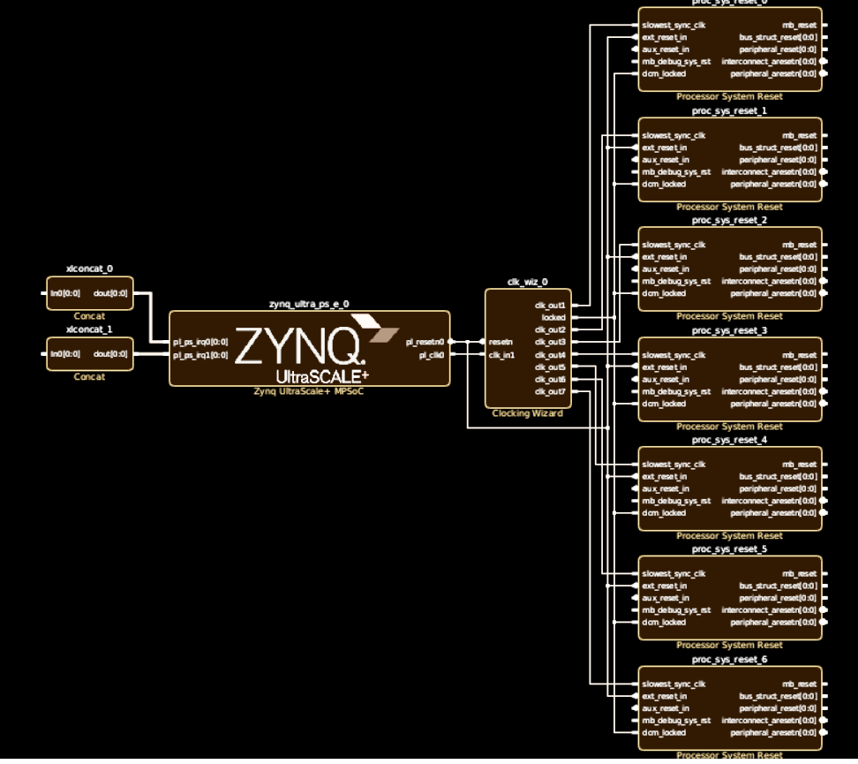
DSA created
1. Vivado create hw base system

Slide 11
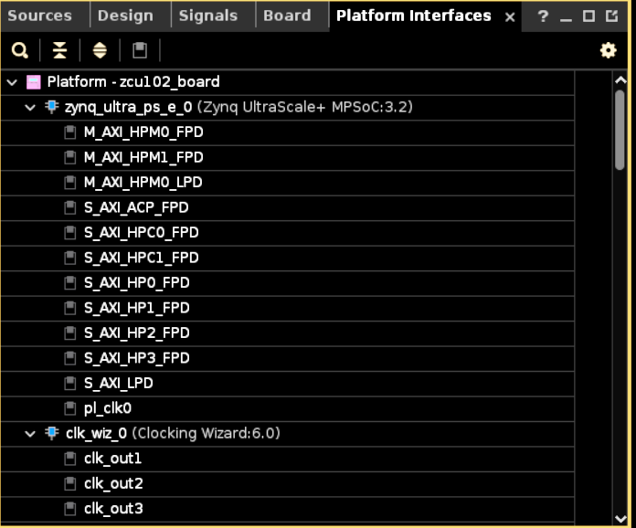
2. enable platform interfaces

Slide 12
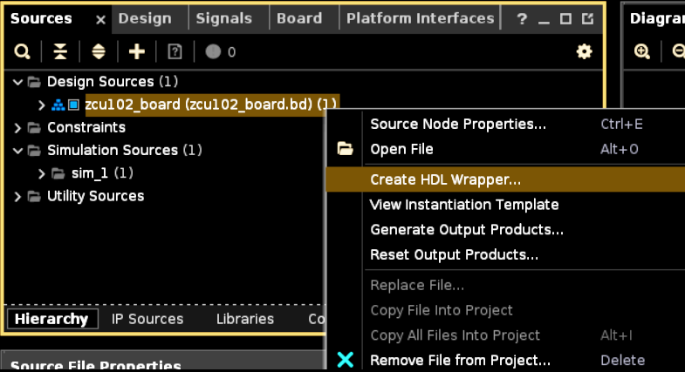
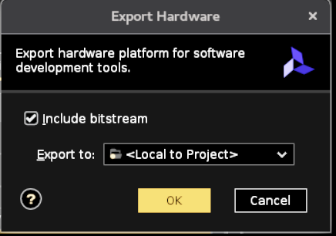
3. HDL wrapper
4. export HW
5. write out DSA

Slide 13
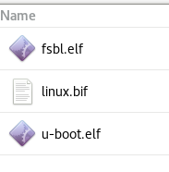

SW-use petalinux to create u-boot, kernel, fsbl, device-tree
Pls refer SDSoC Environment Platform Development Guide

Slide 14
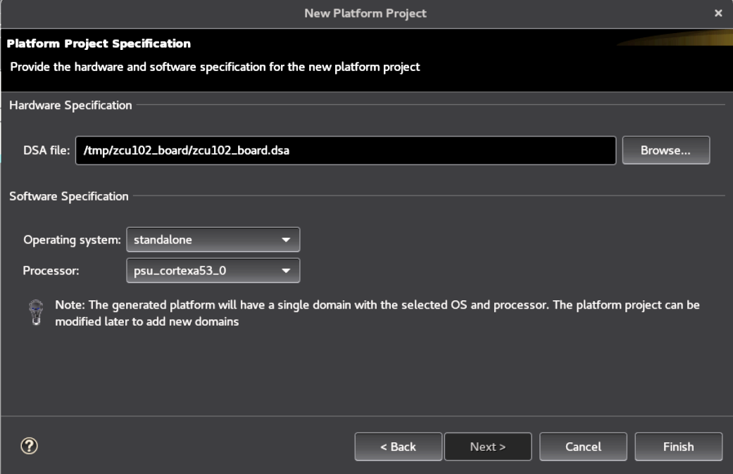
Create platform project

Slide 15
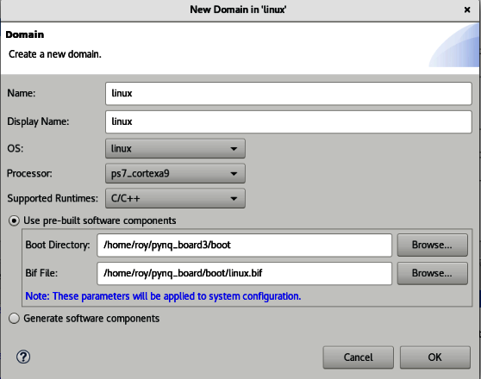
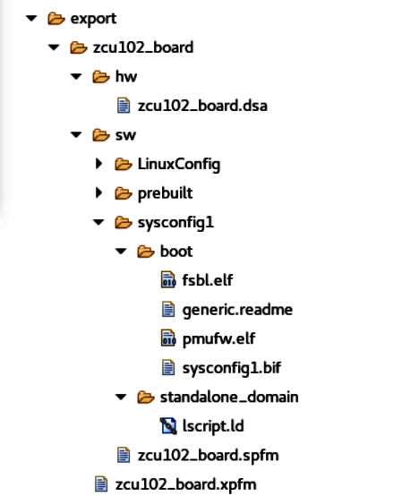
Create for linux use
Build

Slide 16
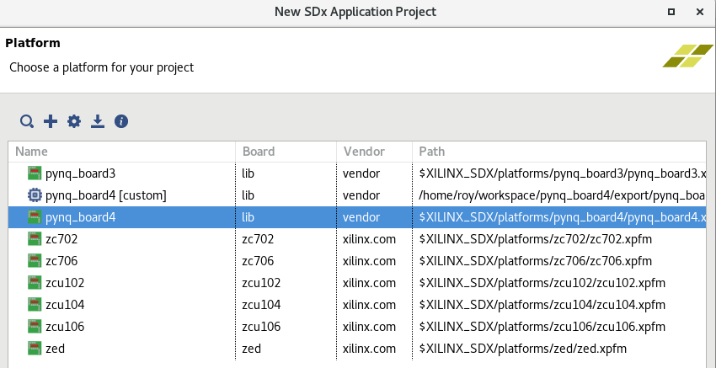
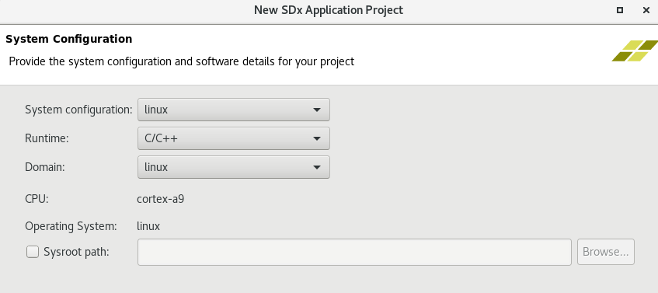
Application project
Create app project, choose platform

Slide 17
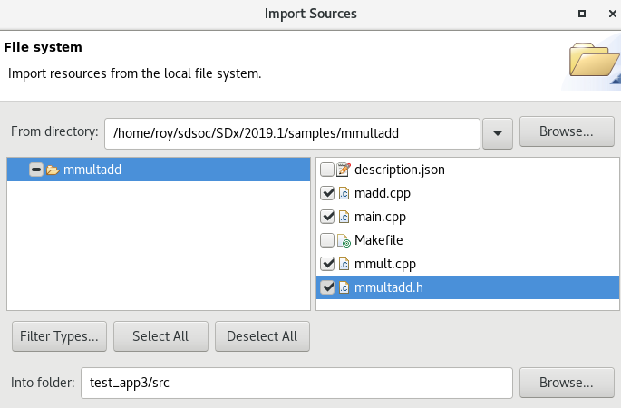
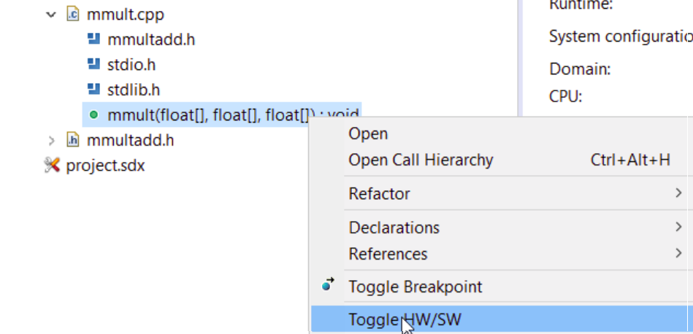
Choose acceleration fun

Slide 18
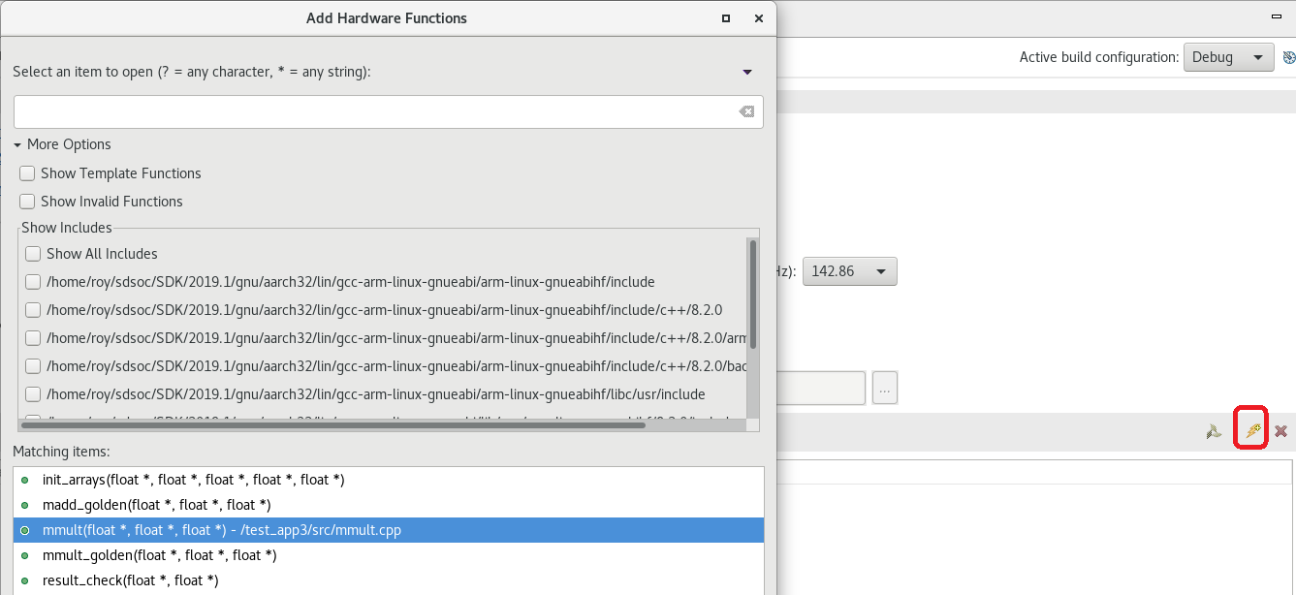
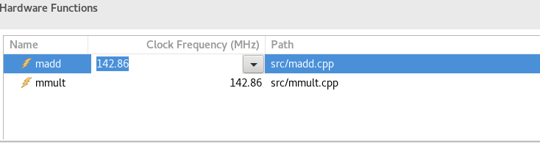

Slide 19
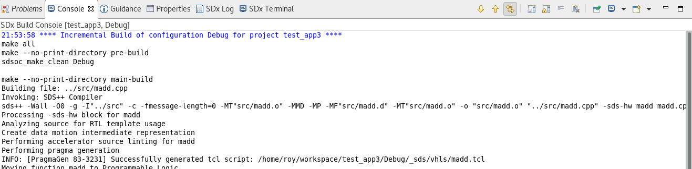
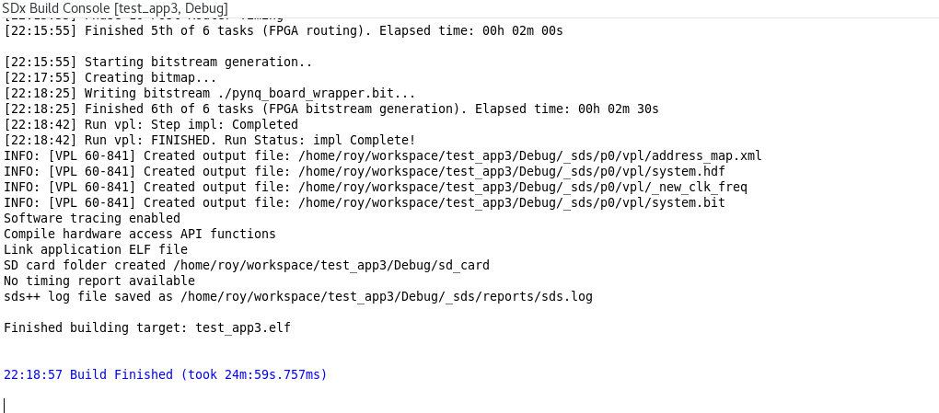
Build project

Slide 20
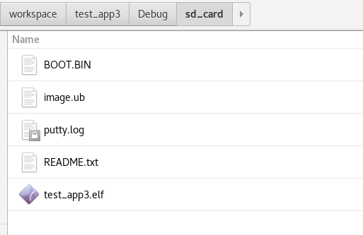
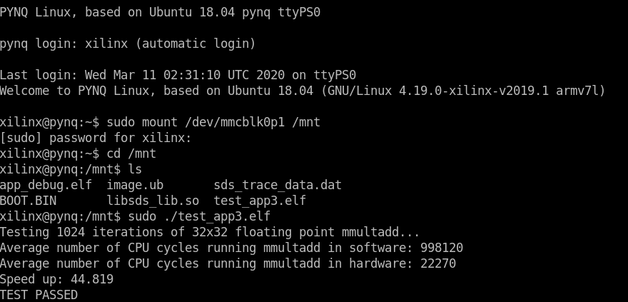
Test app
Copy to sd card & execute

Slide 21
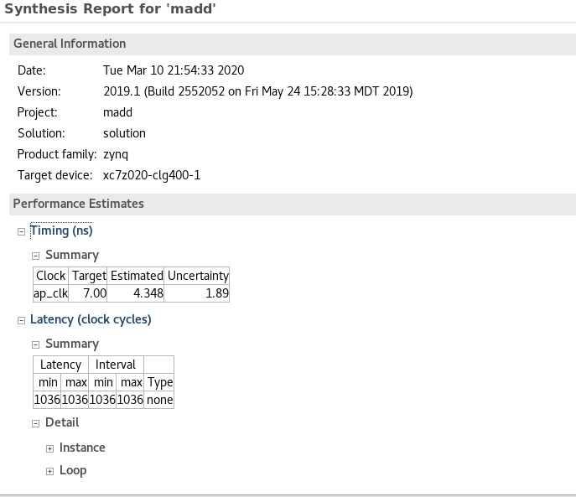
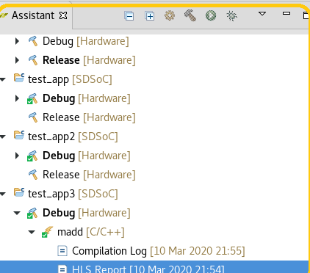

Slide 22
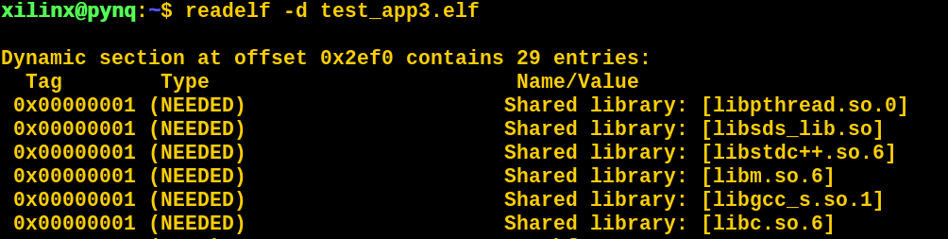
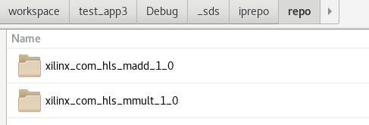
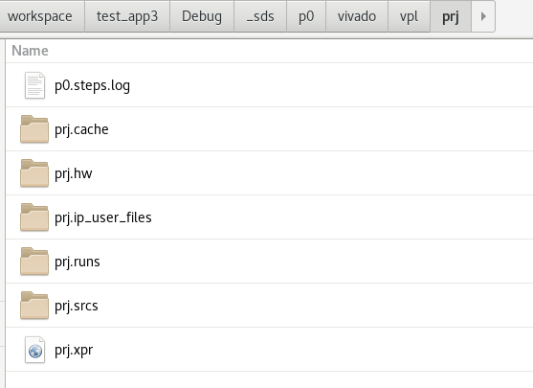

Slide 23
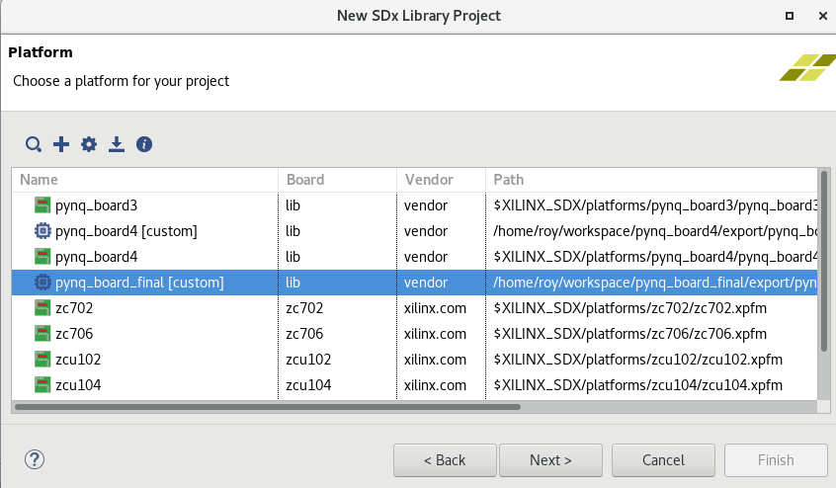
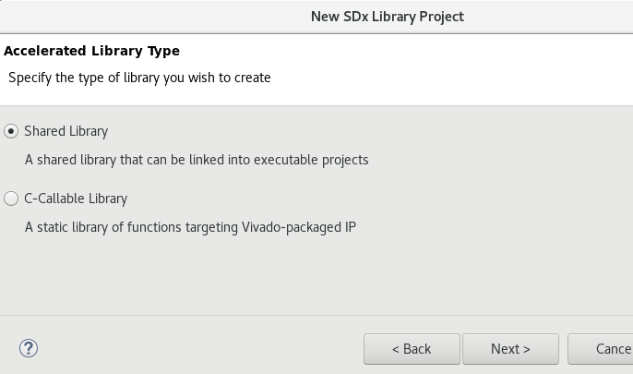
Library project
Estimate performance- no synthesize system to bitstream

Slide 24
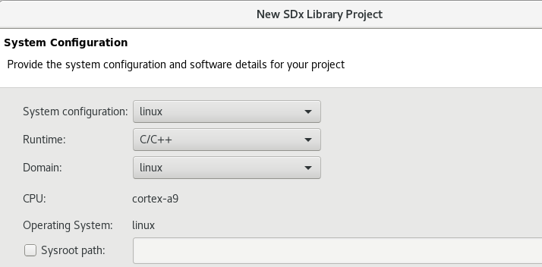
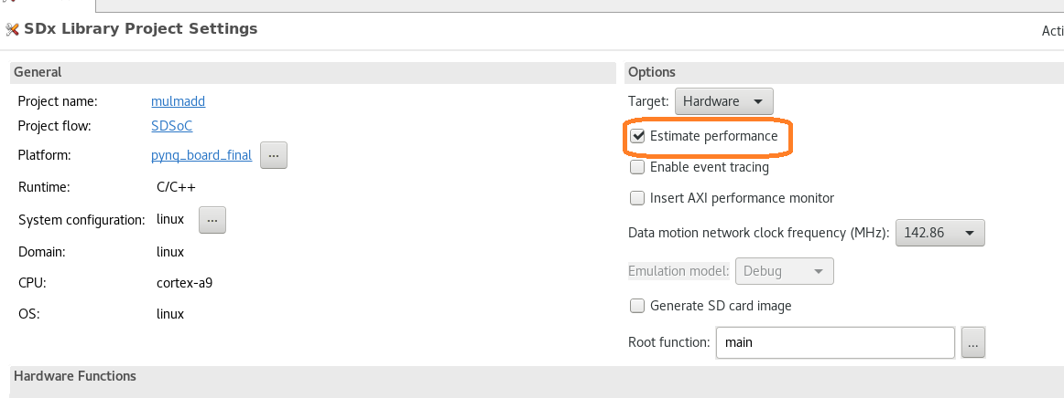

Slide 25
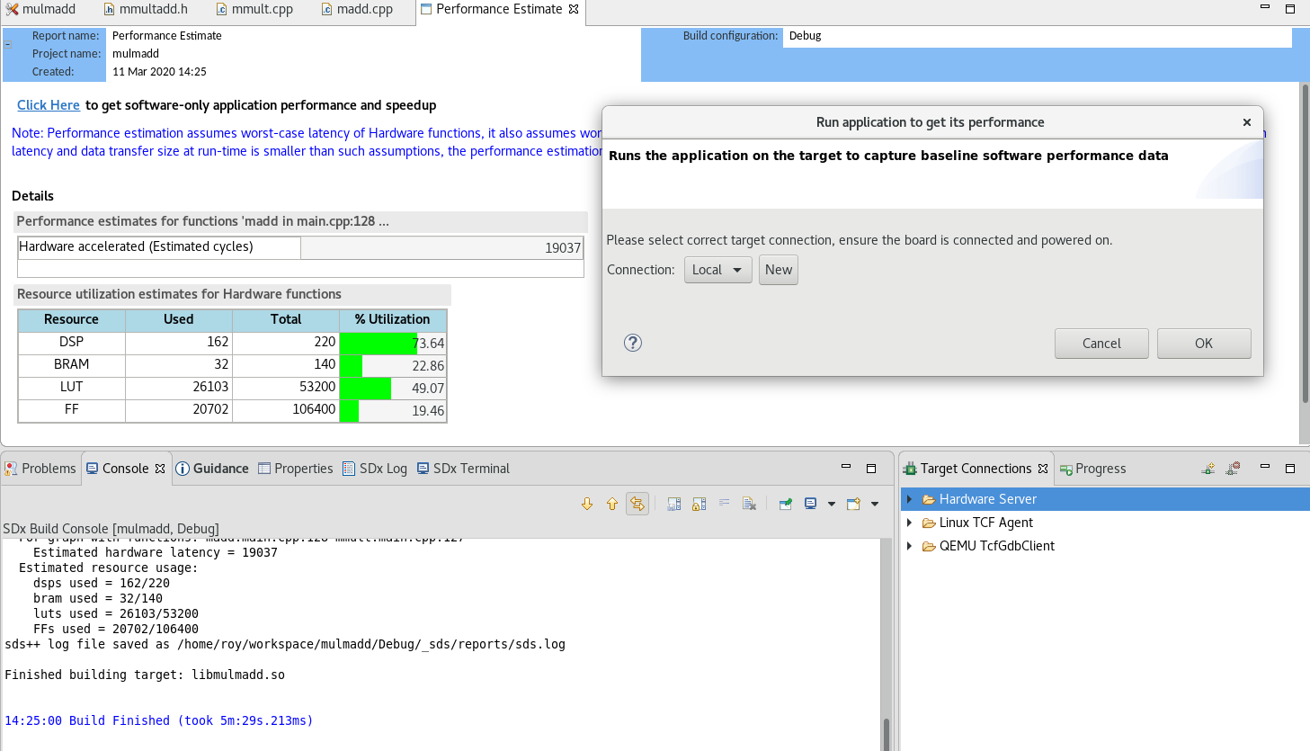
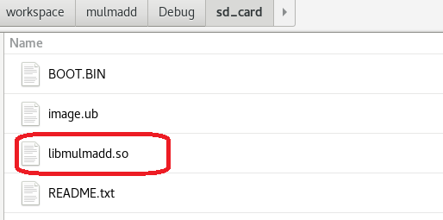

Slide 26
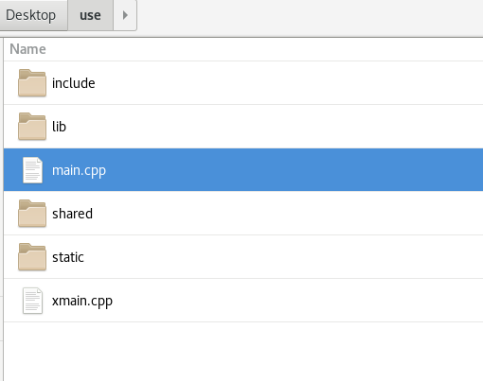
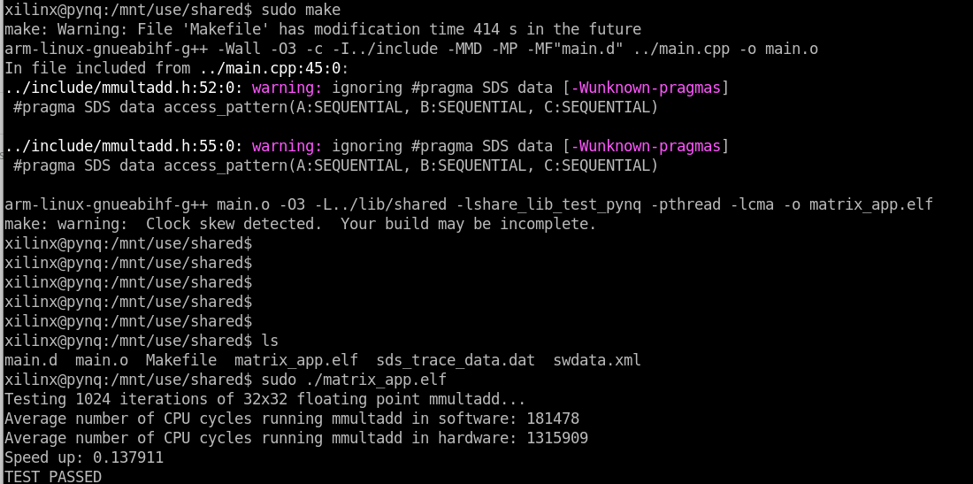
Test .so
copy above files & edit main.cpp, makefile, included library to Boot Zone of SD card:

Slide 27
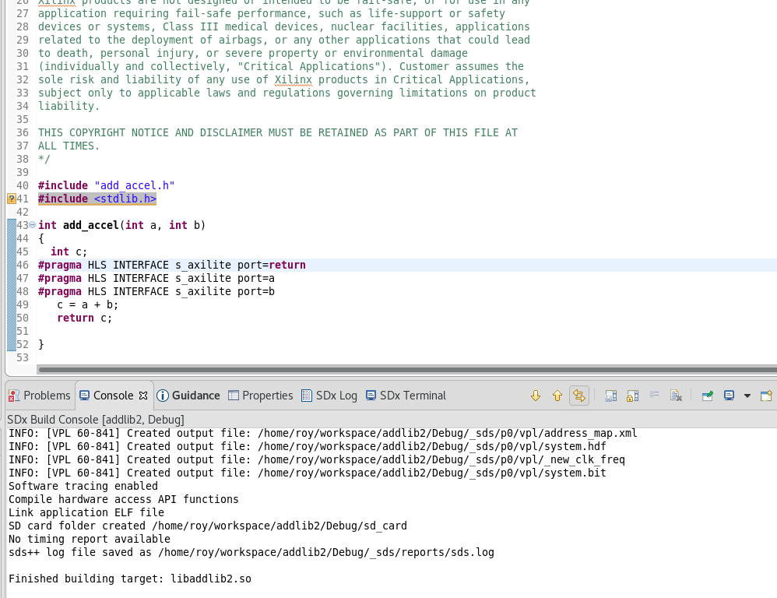

Slide 28
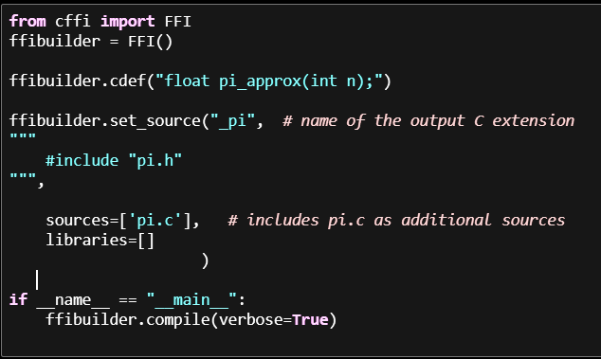
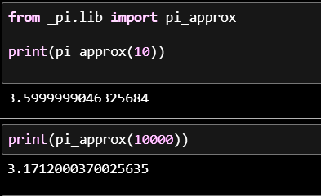
在python 可以利用CFFI (C Foreign Function Interface) 來直接呼叫c語言的程式 有ABI(accesses libraries at the binary level) API,各自都有in-line(即時)/out-of-line(離線)模式 共4種 API執行速度比較快

Slide 29
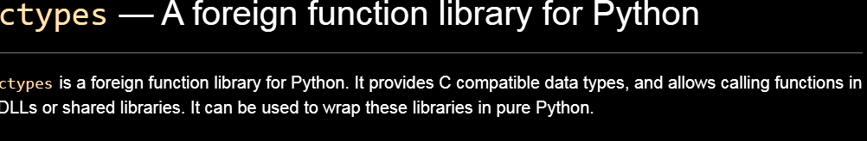
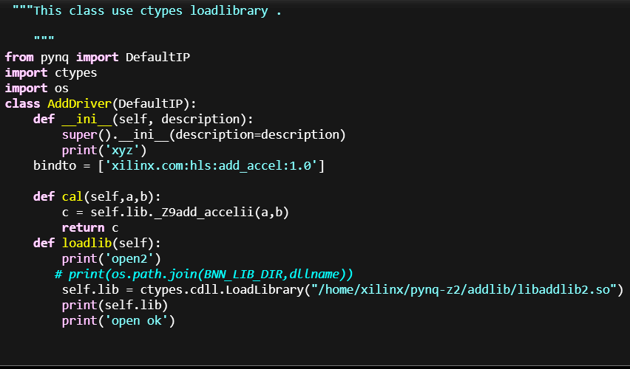
ctypes — A foreign function library for Python

Slide 30
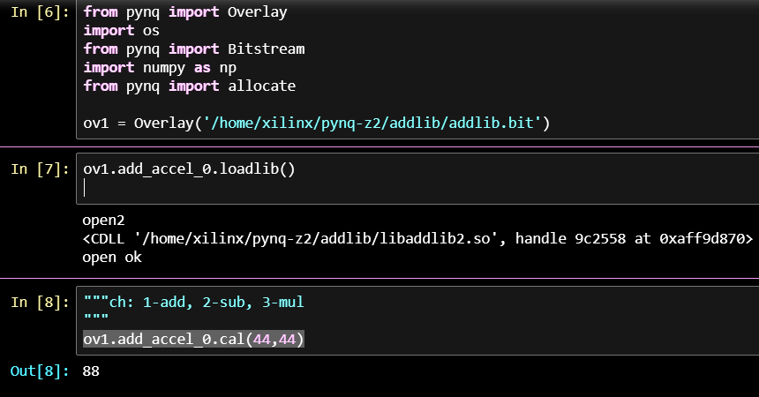

Slide 31
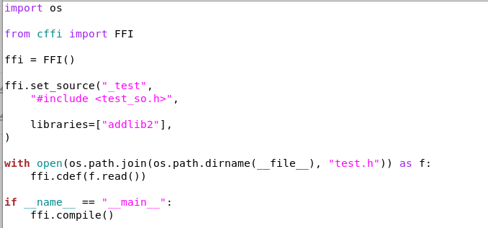
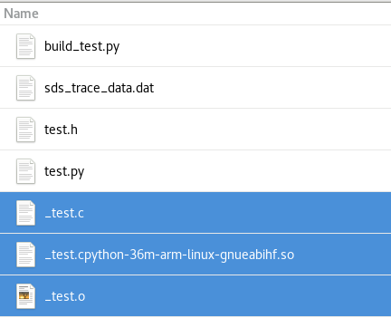
利用cffi 編譯成函數庫

Slide 32
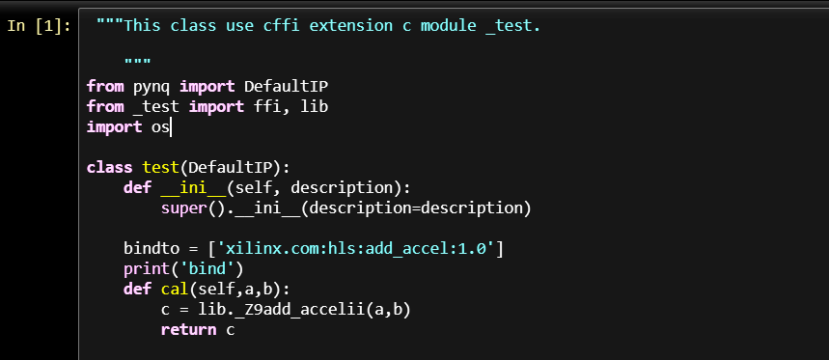

Cffi

Slide 33


Slide 34


Slide 35


Slide 36
reference
1. SDSoC Development Environment Help for 2019.1
2. Xilinx/SDSoC-Tutorials
3. https://www.xilinx.com/products/design-tools/software-zone/sdsoc.html#documentation

